Slide 1
Advanced Regression Techniques in Machine Learning
Session3
Aakash Goel , https://www.linkedin.com/in/goelaakash123/
Acknowledgment: Presentation developed by Prof. Arun. and Modified by Aakash Goel

Slide 2
Introduction to Linear Regression
Linear regression is a fundamental supervised learning technique used to predict a continuous target variable based on one or more predictor variables.
• Simple Linear Regression: Predicts target variable using a single predictor variable.
• Multiple Linear Regression: Uses multiple predictor variables to predict the target variable.

Slide 3
Linear Regression Equation
The linear regression equation can be written as:
y = β0 + β1x1 + β2x2 + ... + βnxn
Where y is the predicted value, β0 is the intercept, β1 to βn are the coefficients, and x1 to xn are the predictor variables.

Slide 4
Assumptions of Linear Regression
For linear regression to provide reliable results, the following assumptions must be met:
• Linearity: The relationship between predictors and target is linear.
Y = mx + c
• Independence: Observations are independent of each other.
• Homoscedasticity: Constant variance of the errors.
• Normality: Errors are normally distributed.

Slide 5
Inputs: Ys, UTS, Hardness, Elongation, diameter
Output: Normal stress

Slide 6
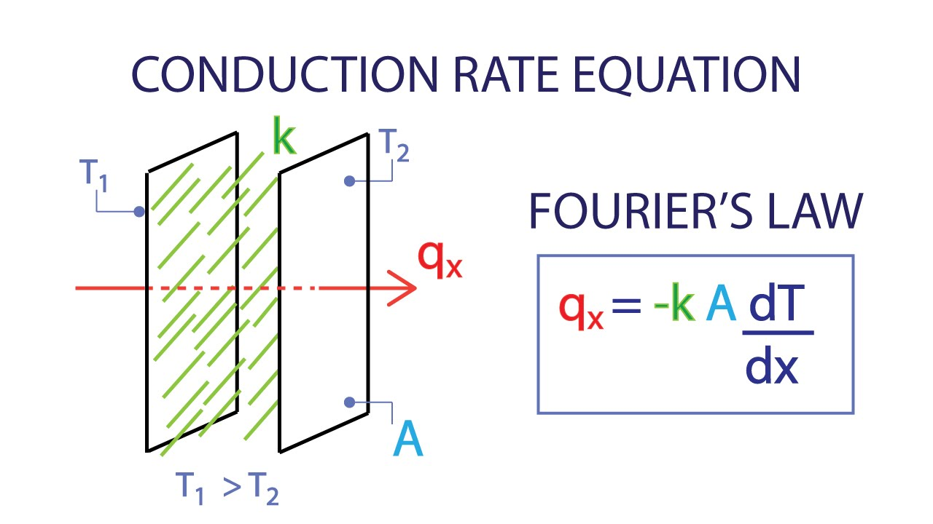

Slide 7

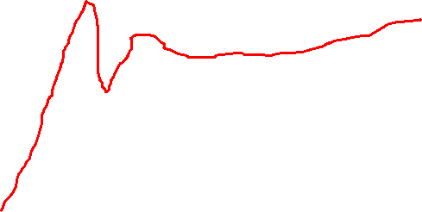
Distance
Acceleration

Slide 8

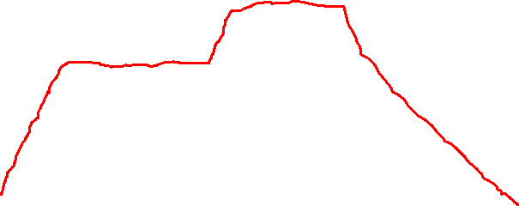
Temperature
Time

Slide 9
Model Evaluation Metrics
To evaluate the performance of a regression model, the following metrics are commonly used:
• Mean Squared Error (MSE): Measures the average squared difference between observed and predicted values.
• Root Mean Squared Error (RMSE): Square root of MSE, providing error in the same units as the target variable.
• R-Squared (R²): Proportion of variance in the target variable explained by the predictors.
• Adjusted R-Squared: Adjusted for the number of predictors in the model, preventing overestimation.

Slide 10
X1 | X2 | X3 | X4 | X5 | Y
Diff I and O flow | Power generated | Flu gas temperature | Flu gas pressure | Tube age | Leakage level (ml/s)
R2 = 0.8 = 80%
Adj R2 = 70%
X1 | X2 | X3 | X4 | X5 | X6 | X7 | Y
Diff I and O flow | Power generated | Flu gas temperature | Flu gas pressure | Tube age | Acoustics spectrum | Scaling level on the tube | Leakage level (ml/s)

Slide 11
Mean Squared Error (MSE) and Root Mean Squared Error (RMSE)
Mean Squared Error (MSE):
MSE = (1/n) Σ (yi - ŷi)²
Root Mean Squared Error (RMSE):
RMSE = sqrt(MSE)

Slide 12
R-Squared (R²) and Adjusted R-Squared
R-Squared (R²):
R² = 1 - (SSres / SStot)
Adjusted R-Squared:
Adjusted R² = 1 - [(1 - R²) * (n - 1) / (n - p - 1)]

Slide 13
Lasso Regression
Lasso Regression (Least Absolute Shrinkage and Selection Operator):
• Uses L1 regularization, adding a penalty equal to the absolute value of the coefficients.
• Encourages sparsity, setting some coefficients to zero, effectively selecting features.

Slide 14
Ridge Regression
Ridge Regression:
• Uses L2 regularization, adding a penalty equal to the square of the coefficients.
• Prevents overfitting by shrinking the coefficients, but does not set them to zero.

Slide 15
Elastic Net Regression
Elastic Net Regression:
• Combines L1 and L2 regularization penalties.
• Balances the benefits of both Lasso and Ridge regression.

Slide 16
Fitting vs. Overfitting
Understanding Fitting and Overfitting:
• Underfitting: Model is too simple, captures little variation from the data.
• Overfitting: Model is too complex, captures noise along with underlying patterns.
• Proper Fitting: Balances complexity and simplicity to generalize well to new data.
• Example Visualization: Plot showing underfit, overfit, and properly fit models.

Slide 17
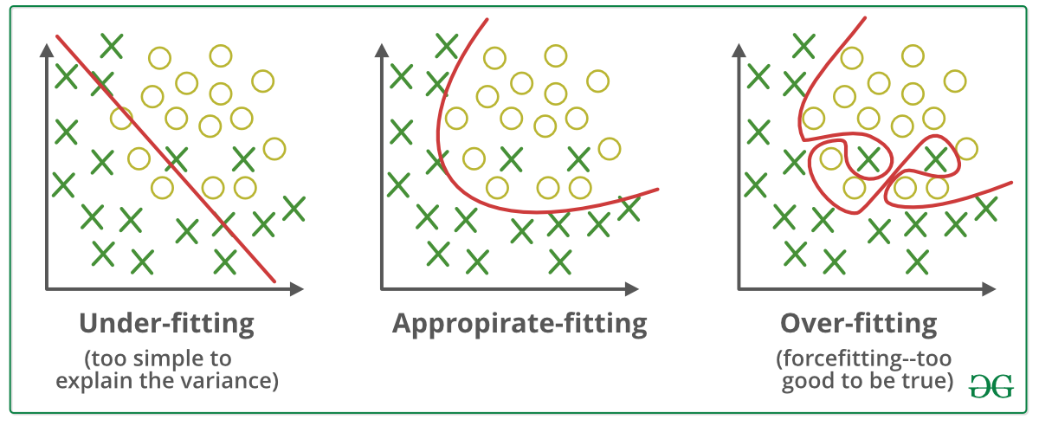

Slide 18
Introduction to Model Performance
ML | Underfitting and Overfitting
- Model Performance: Accuracy and prediction errors are key indicators.
- Generalization: A good model accurately predicts new, unseen data.
- Challenges: Overfitting and underfitting can cause poor model performance.

Slide 19
Bias and Variance in Machine Learning
- Bias: Error due to overly simplistic assumptions.
- High bias leads to underfitting.
- Poor performance on both training and testing data.
- Variance: Error due to sensitivity to training data fluctuations.
- High variance leads to overfitting.
- Good training performance, poor testing performance.

Slide 20
Underfitting in Machine Learning
- Definition: Model is too simple to capture data complexities.
- Characteristics: High bias, low variance, poor performance on training and testing data.
- Causes:
- Simple model with oversimplified assumptions.
- Inadequate input features.
- Small training dataset.
- Excessive regularization.
- Unscaled features.
- Solutions:
- Increase model complexity.
- Enhance feature representation.
- Increase training data.
- Reduce regularization.

Slide 21
Overfitting in Machine Learning
- Definition: Model learns noise and inaccuracies, poor testing performance.
- Characteristics: High variance, low bias.
- Causes:
- Complex model.
- Large training dataset.
- Non-parametric and non-linear methods.
- Solutions:
- Improve training data quality.
- Increase training data.
- Reduce model complexity.
- Early stopping.
- Regularization techniques (Ridge, Lasso).
- Use dropout for neural networks.

Slide 22
Achieving a Good Fit
- Definition: Achieved when the model predicts with minimal error.
- Balance: Between overfitting and underfitting.
- Method:
- Monitor model learning over time.
- Stop training before error increases.
- Ensures good performance on both training and testing data.

Slide 23
Model Selection Trade-Off
Key Considerations in Model Selection:
• Bias-Variance Trade-Off: Balancing bias (error from wrong assumptions) and variance (error from sensitivity to fluctuations).
• Complexity vs. Interpretability: More complex models may perform better but are harder to interpret.
• Computational Resources: Trade-off between model performance and computational efficiency.
• Cross-Validation: Technique to evaluate model performance and select the best model.

Slide 24
XGBoost
XGBoost (eXtreme Gradient Boosting):
• Advanced implementation of gradient boosting.
• Efficient, accurate, and handles large datasets well.

Slide 25
XGBoost Key Parameters
Important Parameters in XGBoost:
• Learning Rate (eta): Controls the step size during optimization.
• Number of Trees (n_estimators): Number of trees to be built.
• Maximum Depth (max_depth): Maximum depth of each tree.
• Subsample: Proportion of data used to build each tree.
• Regularization Terms (alpha, lambda): L1 and L2 regularization terms.

Slide 26
XGBoost: Advanced Features
Advanced Features in XGBoost:
• Tree Pruning: Stops the creation of new branches when further splitting adds no benefit.
• Handling Missing Values: Automatically learns the best way to handle missing data.
• Parallel Processing: Utilizes multiple cores of the CPU to speed up training.
• Regularization: Uses L1 and L2 regularization to prevent overfitting.

Slide 27
XGBoost: Practical Implementation
Steps to Implement XGBoost in Python:
1. Import necessary libraries.
2. Load and preprocess the data.
3. Define the XGBoost model with desired parameters.
4. Train the model on the training data.
5. Evaluate the model on the test data.
6. Tune hyperparameters to optimize performance.

Slide 28
XGBoost: Example Code
Example Code for XGBoost in Python:
```python
import xgboost as xgb
from sklearn.model_selection import train_test_split
from sklearn.metrics import mean_squared_error
# Load dataset
X, y = load_your_data()
# Split data into training and testing sets
X_train, X_test, y_train, y_test = train_test_split(X, y, test_size=0.2, random_state=42)
# Create XGBoost model
model = xgb.XGBRegressor(objective='reg:squarederror', n_estimators=100, learning_rate=0.1, max_depth=5, alpha=10, lambda=10)
# Train the model
model.fit(X_train, y_train)
# Make predictions
y_pred = model.predict(X_test)
# Evaluate the model
mse = mean_squared_error(y_test, y_pred)
print(f"Mean Squared Error: {mse}")
```

